Slide 1

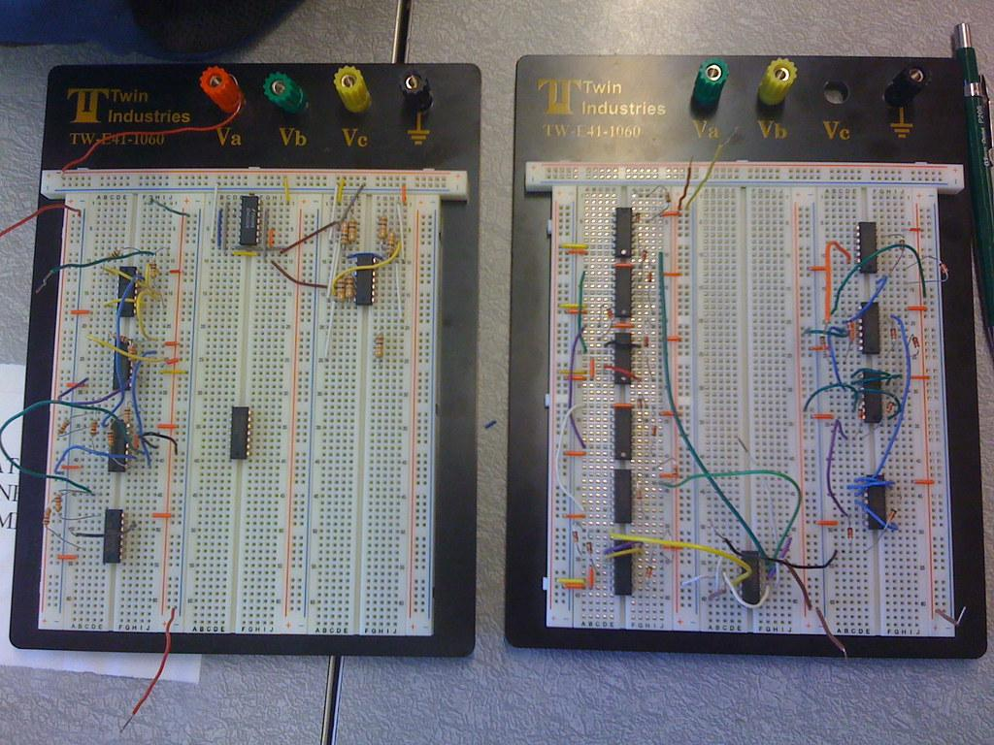

Department of Computer Science and Engineering, BRAC University
CSE 260
Digital Logic Design

Slide 2



Department of Computer Science and Engineering
CSE260 - Digital Logic Design
We Will Learn About
01
Number System and Representation
02
Boolean Algebra and Logic Gates
03
SOP & POS and KMAP
04
Combinational Circuits
05
Sequential Circuits
06
Registers and Memory

Slide 3
Department of Computer Science and Engineering
CSE260 - Digital Logic Design
Textbooks
Core Texts
Reference
Digital Logic And Computer Design, Morris Mano
Digital Design Principles and Practices, John F. Wakerly

Slide 4
Department of Computer Science and Engineering
CSE260 - Digital Logic Design
Marking Distribution
01
Attendance
5%
02
Quiz (N-1)
15%
03
Assignment (All counted, Average)
5%
04
Mid (No option will be given)
25%
05
Final (1 option will be given)
30%
06
Lab (Includes Lab Final & Project)
20%

Slide 5



Department of Computer Science and Engineering
CSE260 - Digital Logic Design
Important Note
01
There is no bonus mark in this course
02
70% Attendance in theory class is mandatory
03
90% Attendance in lab class is mandatory

